Slide 1
AUTOMATIC WATERING SYSTEM FOR PLANTS
SUBMITTED BY,
SREELAKSHMI KRISHNANKUTTY – C0765644
GROUP - 6

Slide 2

DESIGNING THE SCHEMATIC DIAGRAM

Slide 3
Schematic Diagram
A schematic is defined as a picture that, using symbols, shows something in a simple way. A schematic diagram is an image that uses abstract, often structured symbols and lines to represent the components of a process, system, or other entity. Schematic diagrams only display the important components of a structure, although some of the diagram's details may also be exaggerated or added to facilitate the understanding of the system. Schematic diagrams do not contain descriptions that are not required to understand the knowledge intended to be communicated by the diagram. For example, you can see how the wires and components are linked together in a schematic diagram representing an electrical circuit, but not photographs of the circuit itself.

Slide 4
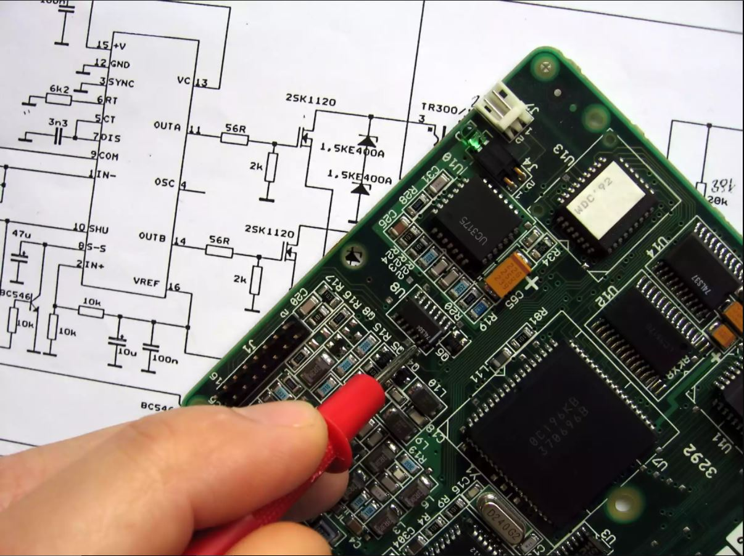
Schematic Diagram
Electrical circuits are usually correlated with schematic diagrams. These diagrams are also called wiring diagrams or circuit diagrams, which show how the various components of a circuit are related. Lines represent connecting wires in these diagrams, while other components are represented by uniform symbols called electrical schematic symbols, such as resistors, lamps, and switches.

Slide 5

SCHEMATIC DESIGNING SOFTWARE
FRITZING

Slide 6
FRITZING
Fritzing is an open-source hardware initiative that makes electronics accessible as a creative material for anyone. It offer a software tool, a community website and services in the spirit of Processing and Arduino, fostering a creative ecosystem that allows users to document their prototypes, share them with others, teach electronics in a classroom, and layout and manufacture professional pcbs.

Slide 7
FRITZING SOFTWARE INSTALLATION
Please make sure your system satisfies one of these requirements:
Windows 10
Windows 7 was reported to work, too
Mac - OSX 10.14 and up, though 10.13 might work too. MacOS 10.15 is currently untested.
Linux - a fairly recent linux distro with libc >= 2.6
Start downloading the Fritzing package that's right for you.

Slide 8
FRITZING SOFTWARE INSTALLATION
Unzip your Fritzing folder somewhere convenient on your hard drive.
This may also be a good time for you to create a shortcut to the Fritzing application.
To start Fritzing:
on Windows: double-click fritzing.exe
on Mac: double-click the Fritzing application
on Linux: double-click Fritzing, or try ./Fritzing in your shell window
If you experience problems, please try downloading again. This often helps. If it doesn't, have a look at our forums.

Slide 9
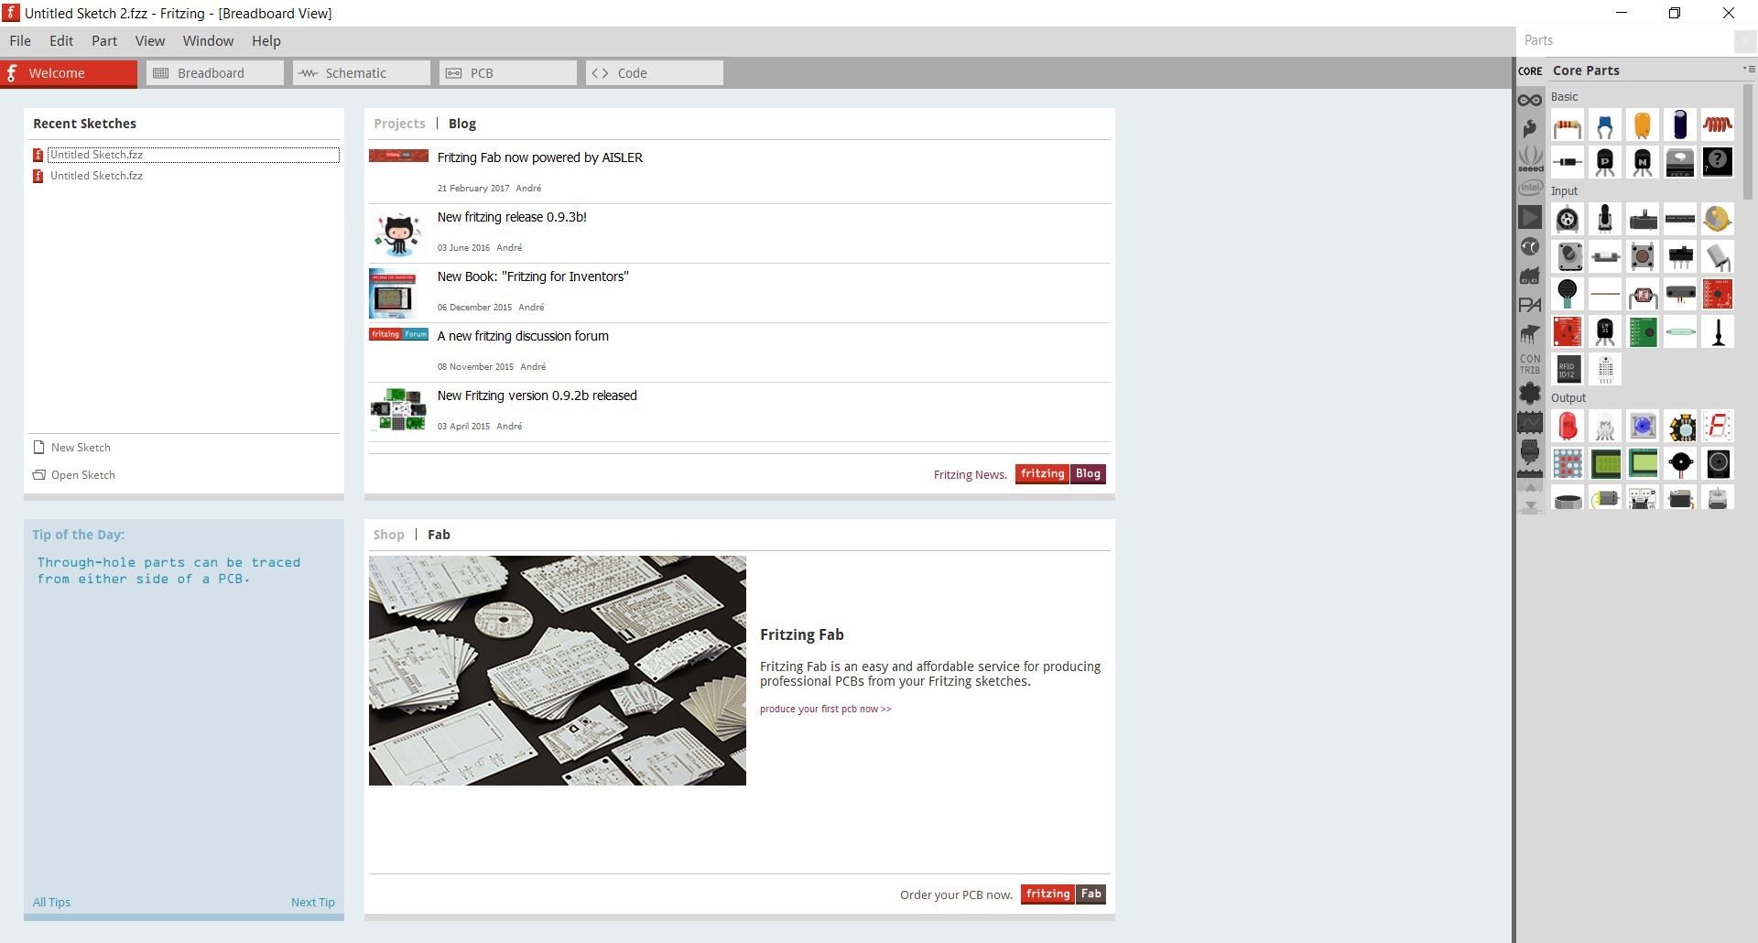
WELCOME SCREEN OF FRITZING SOFTWARE

Slide 10
Fritzing on the BeagleBone Black
If you want to create a breadboard/pcb/schematic layout for your Beaglebone Black, you can use a free program called Fritzing. Following are the steps that we need to use to operate on this software on a Windows operating system.
Install Fritzing
Download the latest version of Fritzing. Make sure to choose the proper operating system.
Unzip the file into the directory that you wish.
Open up the folder that you just unzipped and run the fritzing.exe program.
Import the Beaglebone Black Library

Slide 11
Fritzing on the BeagleBone Black
Go to this website https://github.com/adafruit/Fritzing-Library/blob/master/AdaFruit.fzbz and click the 'View Raw' button to download the latest AdaFruit library.
At the top left of the Fritzing application, click: File>Open>AdaFruit.fzbz
Once the library is imported, exit the Fritzing library. You will be prompted with a box. Make sure to save the changes to your library.
Using Beaglebone Black on Fritzing
Re-open the Fritzing.exe application.

Slide 12
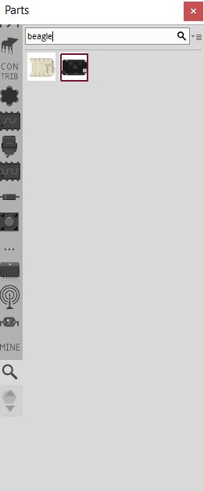
Fritzing on the BeagleBone Black
At the top right, there is a magnifying glass to search for items. Click on it and search for ‘beagle.’

Slide 13
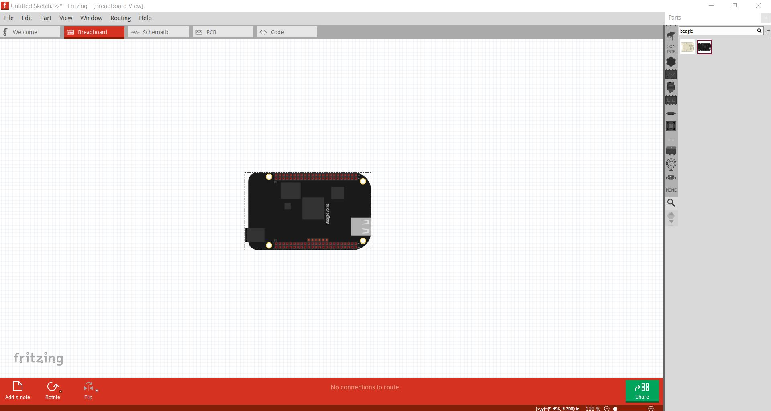
Fritzing on the BeagleBone Black
Simply click on the icon and drag it towards the breadboard and it is ready for use.

Slide 14
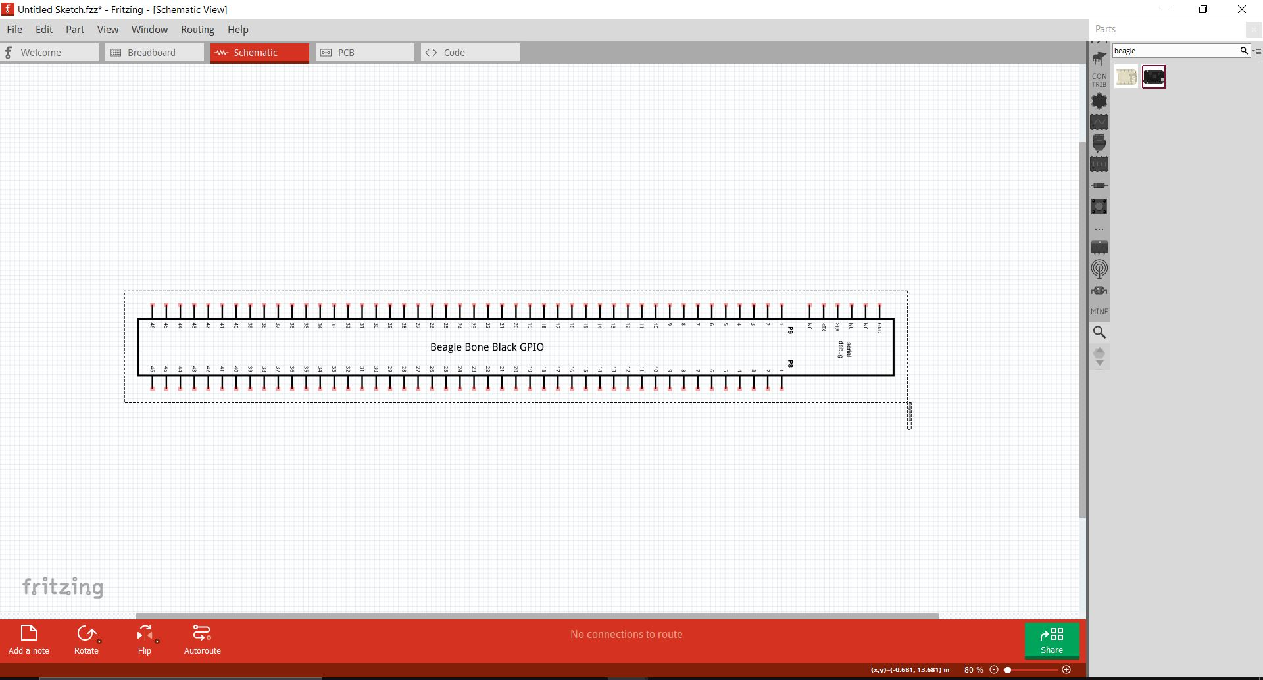
Fritzing on the BeagleBone Black
You can also view its schematic and PCB layout at the top left of the window.

Slide 15
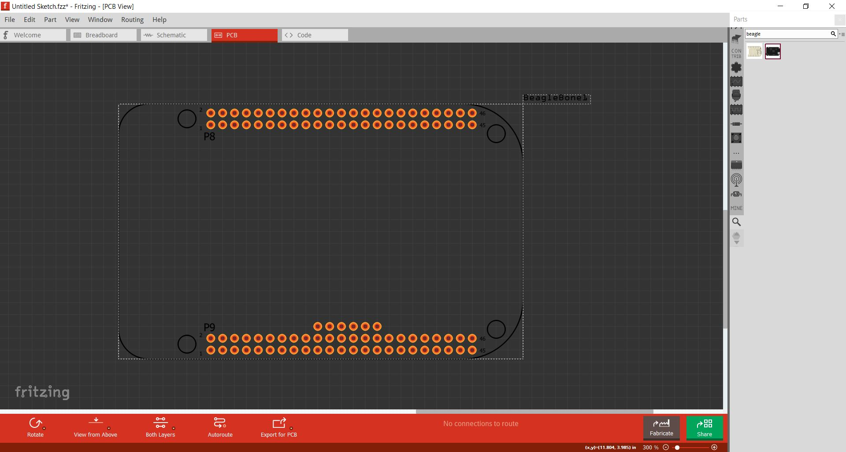
Fritzing on the BeagleBone Black
PCB layout

Slide 16
COMPONENTS THAT WE ARE USING FOR OUR PROJECT
Beagle bone Black
Soil Moisture Sensor(FC-28)
Temperature and Humidity Sensor(DHT22)
Light Sensor(LDR)
Motor Driver(L293D)
DC motor(5-9V)
Resistors
Power Supply
WIFI Module(esp8266 Wi-Fi module)

Slide 17
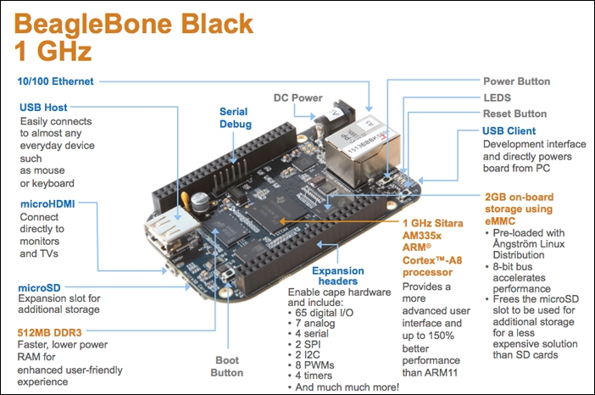
Beagle bone black
As in every computer, the board consists of a power button to turn on and turn off the board and a reset button to reset the board. In addition, there is a boot button which is used to boot the board when the operating system is loaded on the microSD card instead of the eMMC.There is a type A USB Host port to which you can connect peripherals such as USB Keyboard, USB Mouse, USB Camera, and much more, provided that the Linux drivers are available for the peripherals you connect to the BeagleBone Black.You can connect the BeagleBone Black to the LAN or Internet using the Ethernet port available on the board using an Ethernet cable. You can even use a USB Wi-Fi module to give Internet access to your BeagleBone Black.

Slide 18
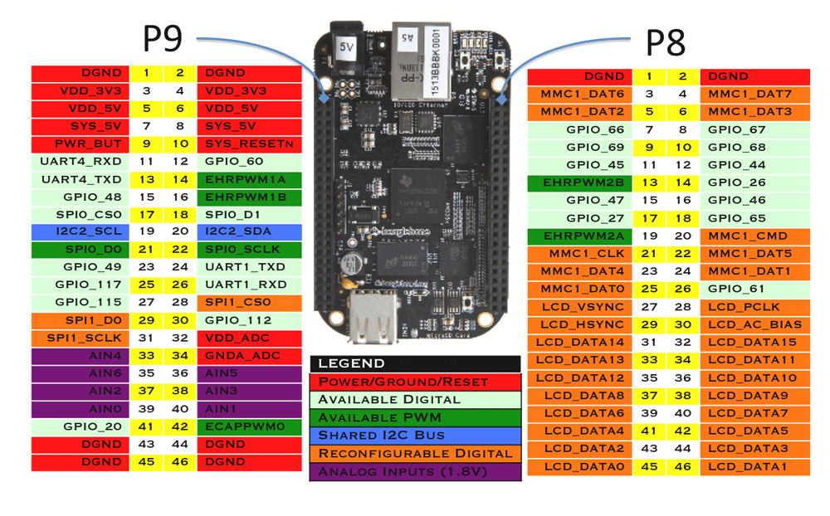
Beagle bone black
The expansion headers which are in general called the General-Purpose Input Output (GPIO) pins include 65 digital pins.

Slide 19
Beagle bone black
These pins can be used as digital input or output pins to which you can connect switches, LEDs and many more digital input output components, 7 analog inputs to which you can connect analog sensors like a potentiometer or an analog temperature sensor, 4 Serial Ports to which you can connect Serial Bluetooth or Xbee Modules for wireless communication or anything else, 2 SPI and 2 I2C Ports to connect different modules such as sensors or any other modules using SPI or I2C communication.

Slide 20
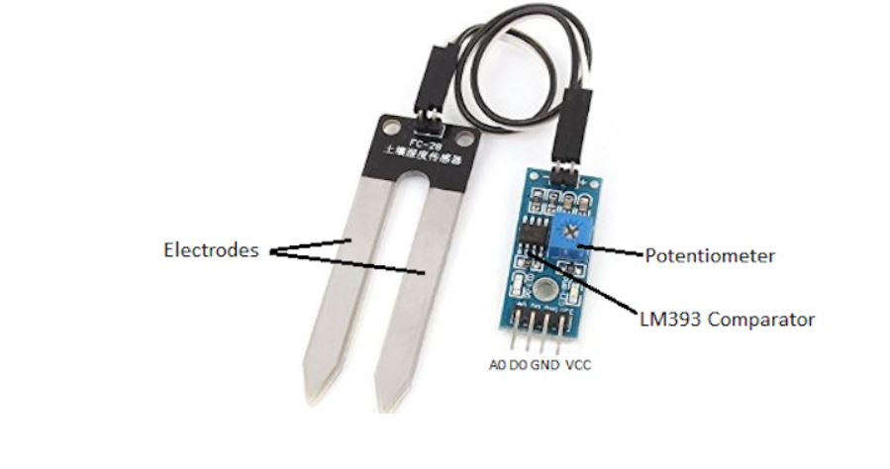
Soil Moisture Sensor(FC-28)
The specifications of the FC-28 soil moisture sensor are as follows:
Input Voltage: 3.3–5V
Output Voltage: 0–4.2V
Input Current: 35mA
Output Signal: both analog and digital
Pin-out
The FC-28 soil moisture sensor has four pins:VCC: Power
A0: Analog Output
D0: Digital Output
GND: Ground
The module also contains a potentiometer, which will set the threshold value. This threshold value will be compared by the LM393 comparator. The output LED will light up and down according to this threshold value.

Slide 21
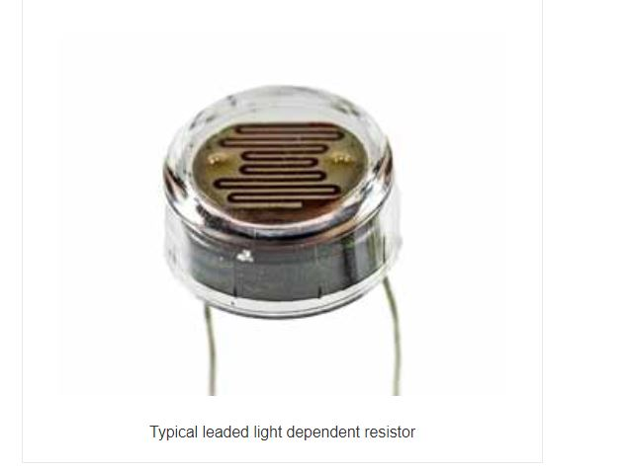
LDR SENSOR
An electronic component which is sensitive to light is a photoresistor or light-dependent resistor. Then the resistance changes as light falls on it. The resistance values of the LDR can alter the value of the resistance dropping over several orders of magnitude as the level of light increases.

Slide 22
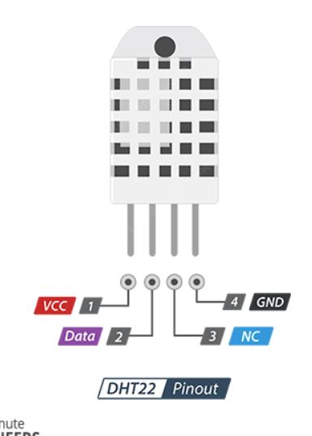
Temperature and Humidity Sensor(DHT22)
VCC pin supplies power for the sensor. Although supply voltage ranges from 3.3V to 5.5V, 5V supply is recommended.
Data pin is used to communication between the sensor and the microcontroller.
NC Not connected
GND should be connected to the ground of the board

Slide 23
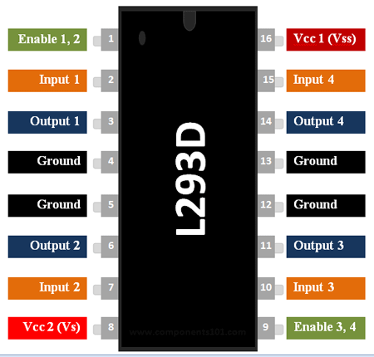
Motor Driver(L293D)
Can be used to run Two DC motors with the same IC.
Speed and Direction control is possible
Motor voltage Vcc2 (Vs): 4.5V to 36V
Maximum Peak motor current: 1.2A

Slide 24
Motor Driver(L293D)
Maximum Continuous Motor Current: 600mA
Supply Voltage to Vcc1(vss): 4.5V to 7V
Transition time: 300ns (at 5Vand 24V)
Automatic Thermal shutdown is available
Available in 16-pin DIP, TSSOP, SOIC packages

Slide 25
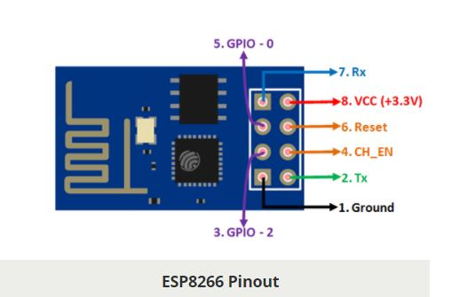
WIFI Module(esp8266 Wi-Fi module)
Low cost, compact and powerful Wi-Fi Module
Power Supply: +3.3V only
Current Consumption: 100mA
I/O Voltage: 3.6V (max)
I/O source current: 12mA (max)

Slide 26
WIFI Module(esp8266 Wi-Fi module)
Built-in low power 32-bit MCU @ 80MHz
512kB Flash Memory
Can be used as Station or Access Point or both combined
Supports Deep sleep (<10uA)
Supports serial communication hence compatible with many development platform like Arduino
Can be programmed using Arduino IDE or AT-commands or Lua Script

Slide 27
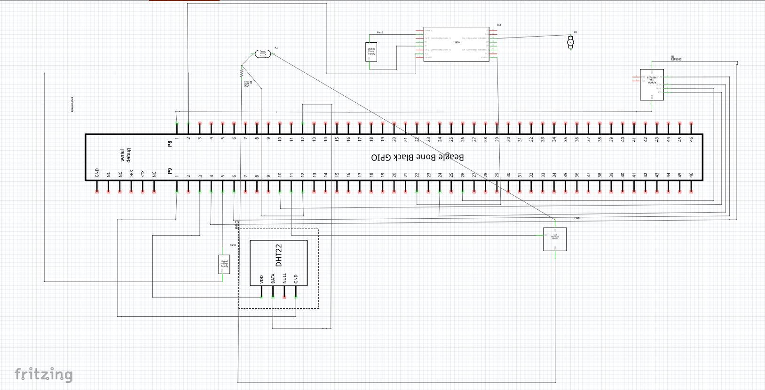
SCHEMATIC DESIGN OF OUR CIRCUIT

Slide 28
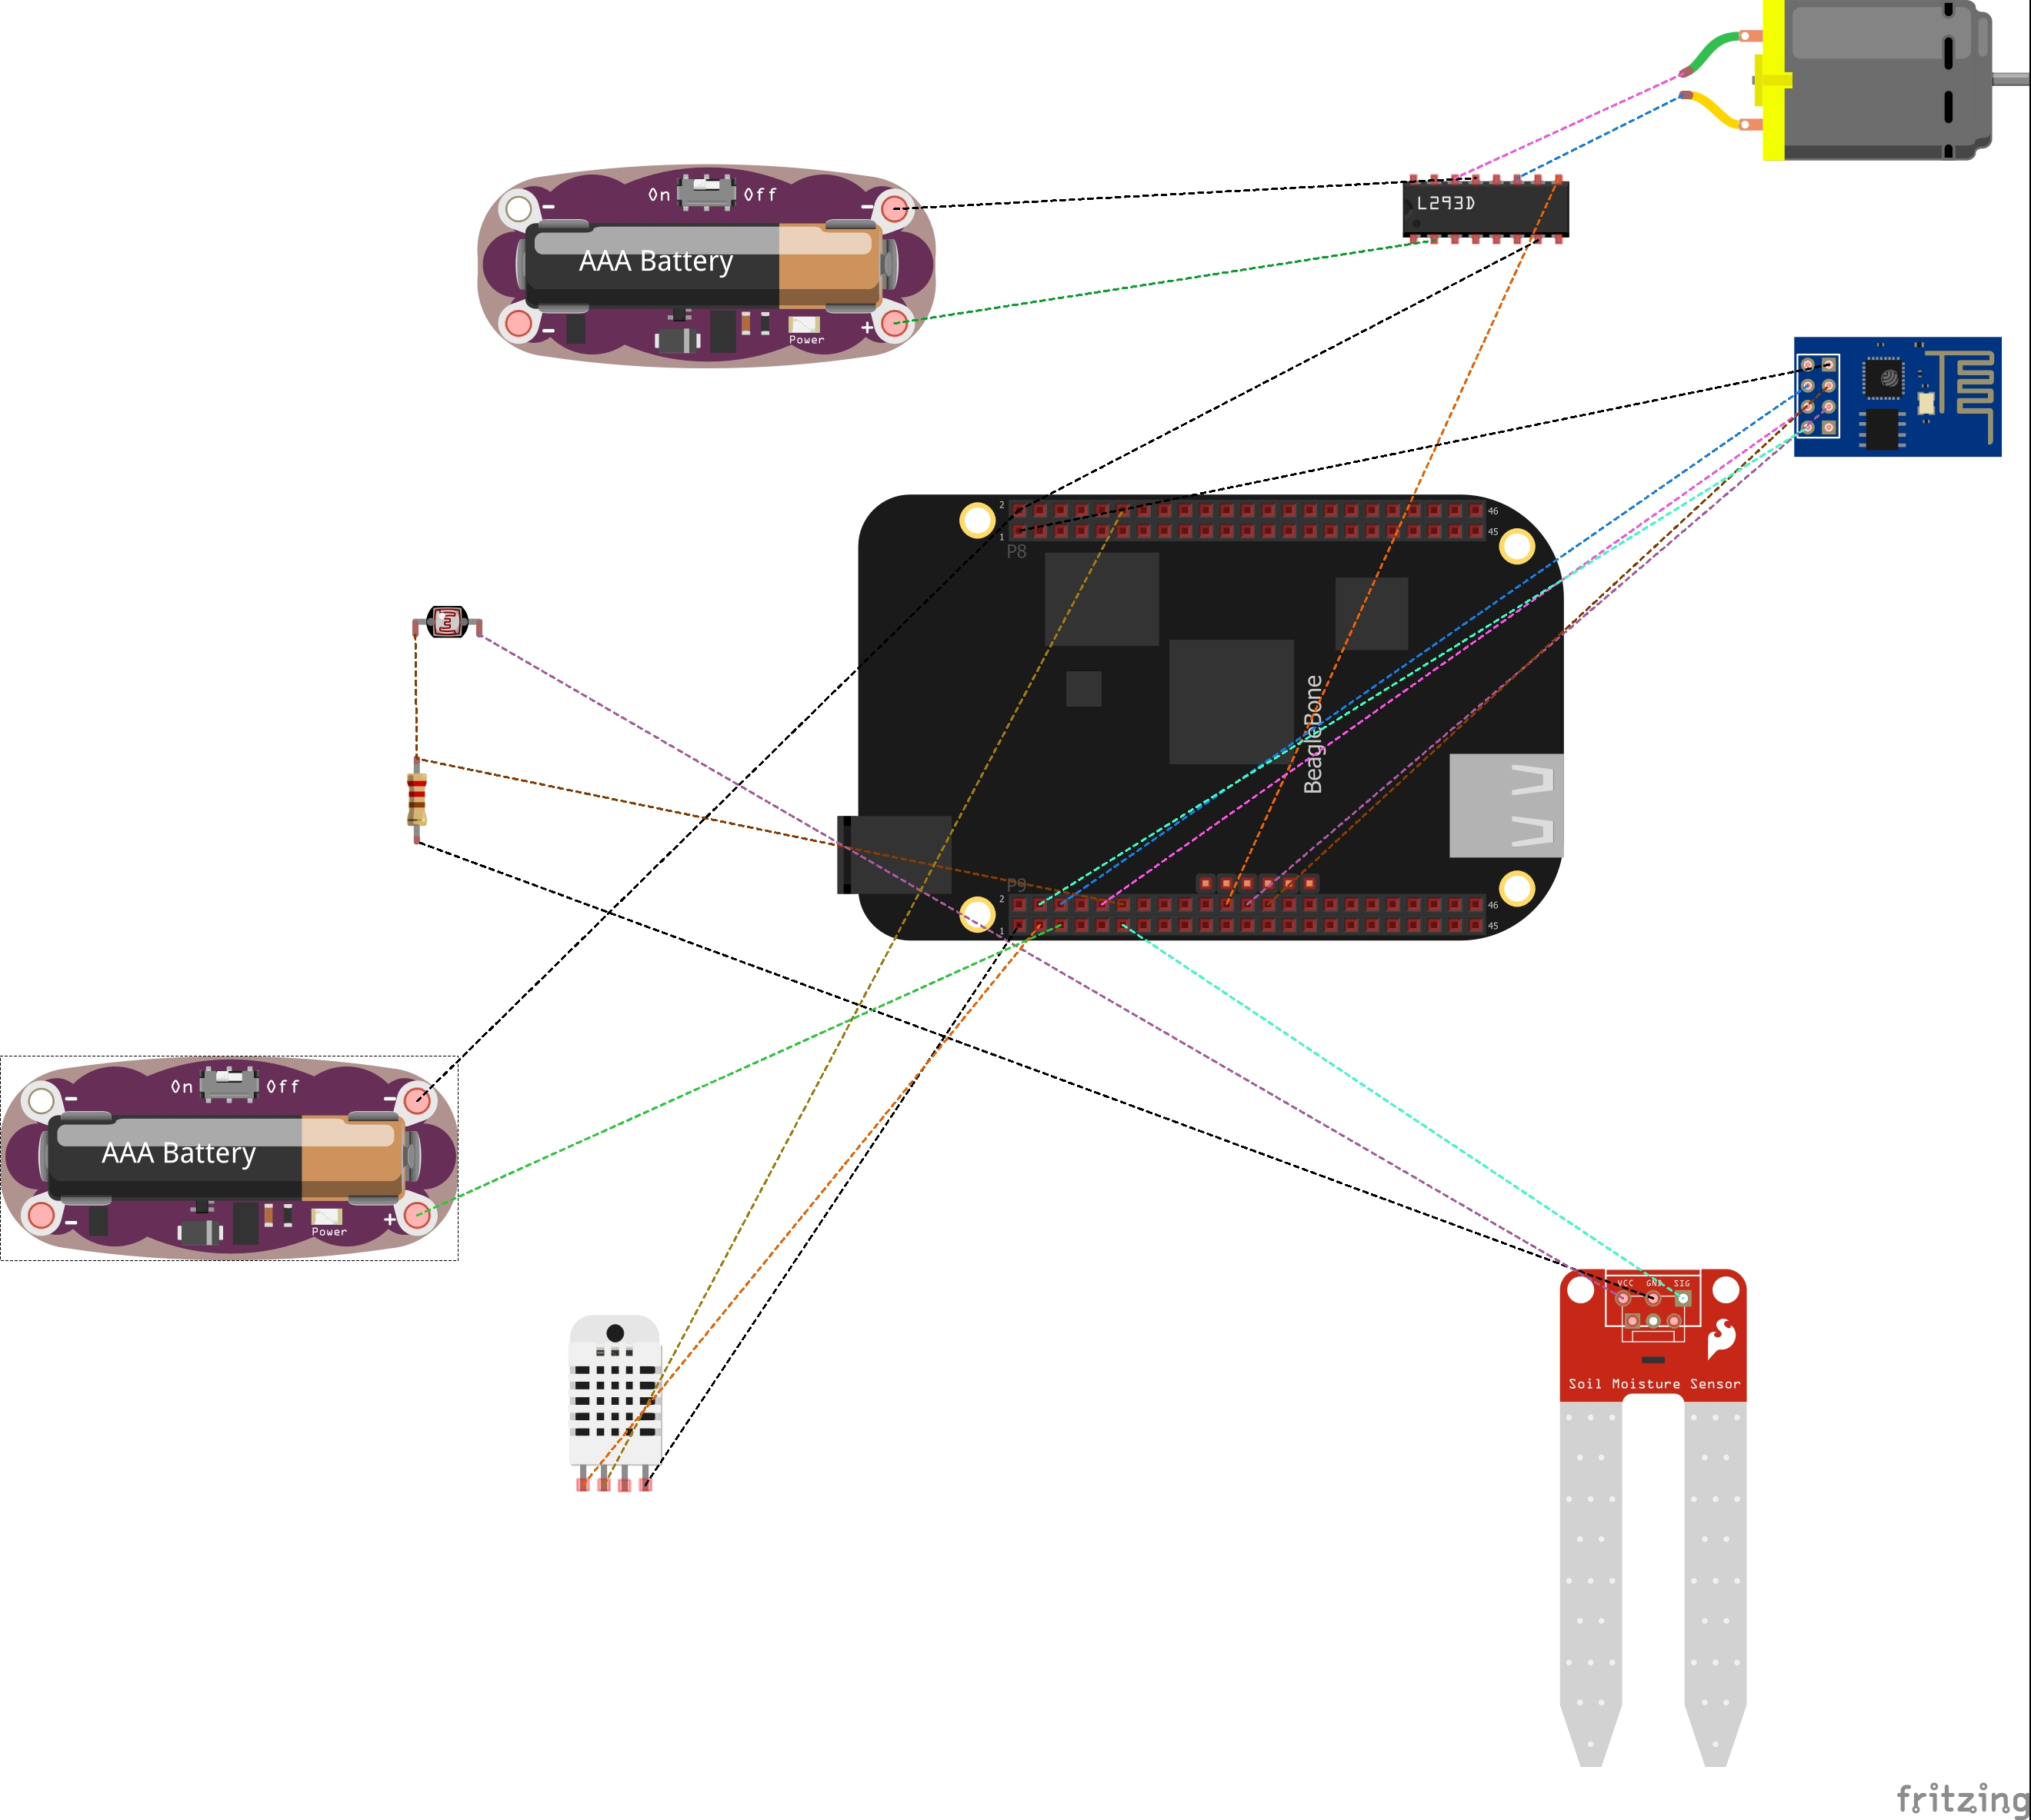
Breadboard layout of our design

Slide 29
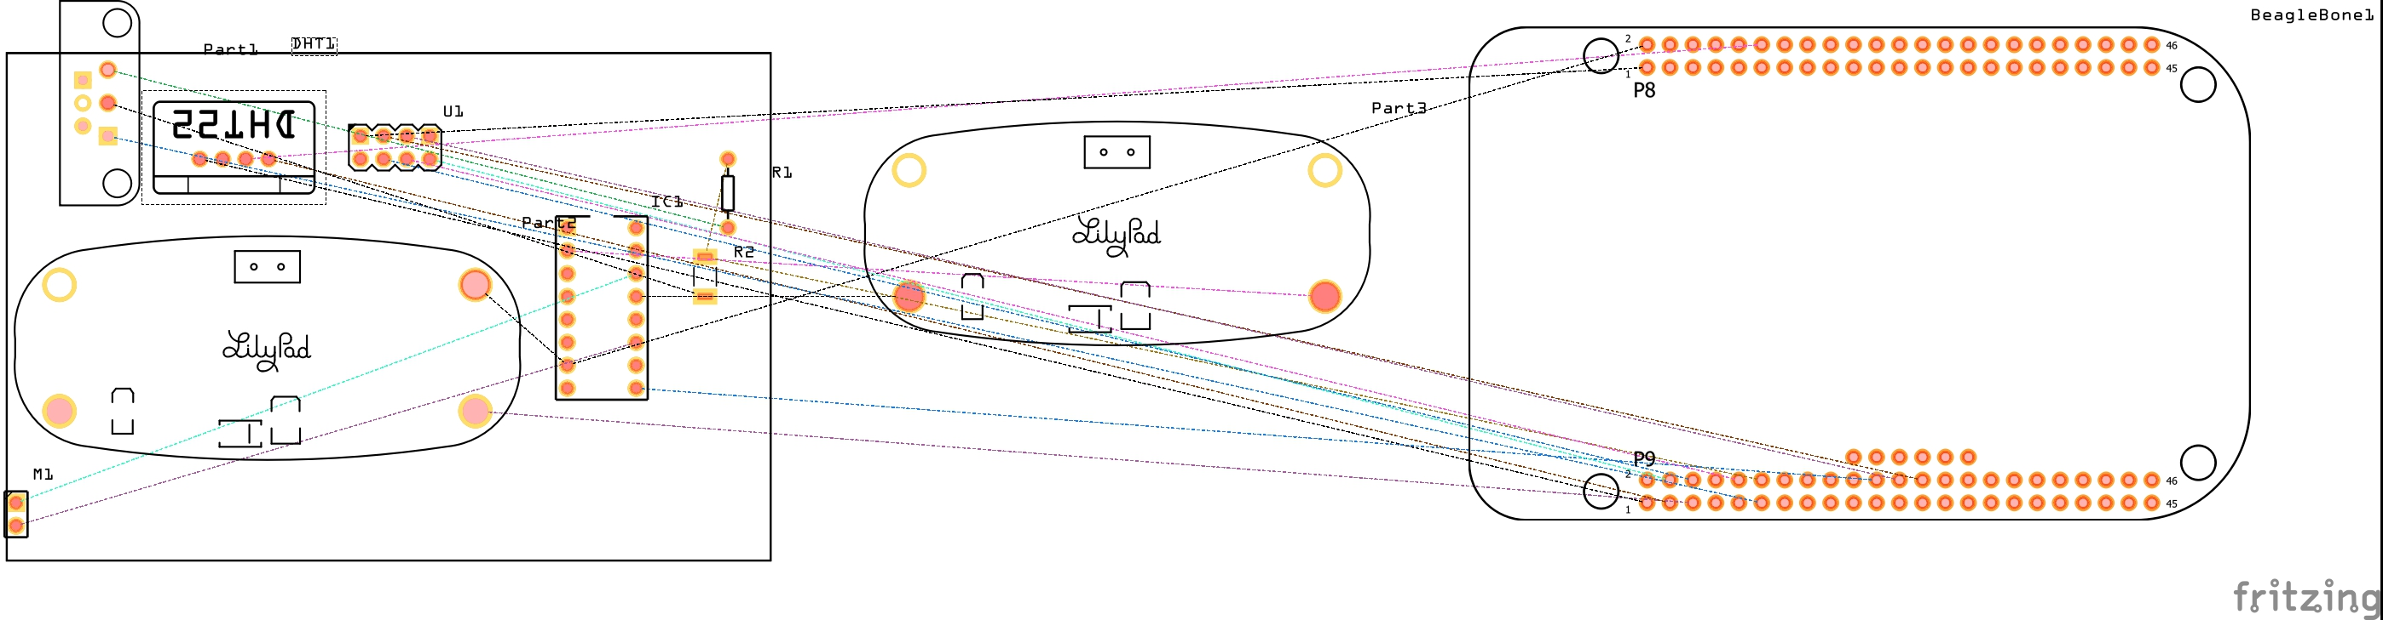
PCB LAYOUT OF OUR DESIGN

Slide 30
REFERENCES
SCHEMATIC DIAGRAM: https://www.thoughtco.com/what-is-a-schematic-diagram-4584811
FRITZING: https://fritzing.org/
DOWNLOADING FRITZING: https://www.filecroco.com/download-fritzing/download/
FRITZING LIBRARY: https://github.com/adafruit/Fritzing-Library/blob/master/AdaFruit.fzbz
FRITZING ON THE BEAGLEBONE BLACK: https://elinux.org/Beagleboard:Fritzing_on_the_BeagleBone_Black#:~:text=If%20you%20want%20to%20create,a%20free%20program%20called%20Fritzing.

Slide 31
REFERENCES
BEAGLEBONE BLACK SPECIFICATIONS: https://subscription.packtpub.com/book/hardware_and_creative/9781785285059/1/ch01lvl1sec11/hardware-specification-of-beaglebone-black
SOIL MOISTURE SENSOR SPECS: https://maker.pro/arduino/projects/arduino-soil-moisture-sensor
Temperature and Humidity Sensor(DHT22): https://lastminuteengineers.com/dht11-dht22-arduino-tutorial/

Slide 32
REFERENCES
Light Sensor(LDR): https://www.electronics-notes.com/articles/electronic_components/resistors/light-dependent-resistor-ldr.php
Motor Driver(L293D): https://components101.com/ics/l293d-pinout-features-datasheet

Slide 33
WIFI Module(esp8266 Wi-Fi module): https://components101.com/wireless/esp8266-pinout-configuration-features-datasheet

Slide 34
THANKYOU

